Slide 1

Design Requirement Presentation
By:
Ian Adelman
Devin Hoopes
Natalie Gonzalez
Alex Reinert

Slide 2




Meet the Team
Ian Adelman
Devin Hoopes
Natalie Gonzalez
Alex Reinert

Slide 3



Agenda
Problem Statement
Requirements
Questions

Slide 4

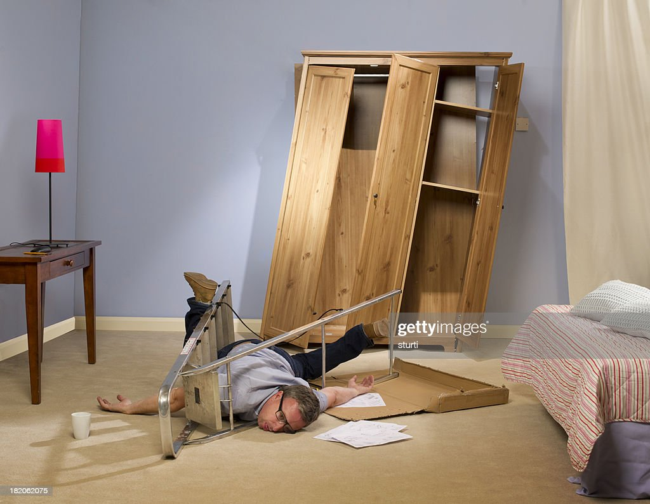
Review of the Problem Statement
Transporting heavy furniture up and down the stairs is difficult and potentially dangerous

Slide 5
Meet the Team
Ian Adelman
Devin Hoopes
Natalie Gonzalez
Alex Reinert

Slide 6
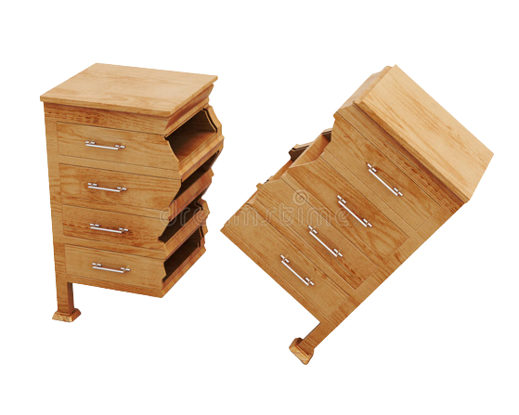

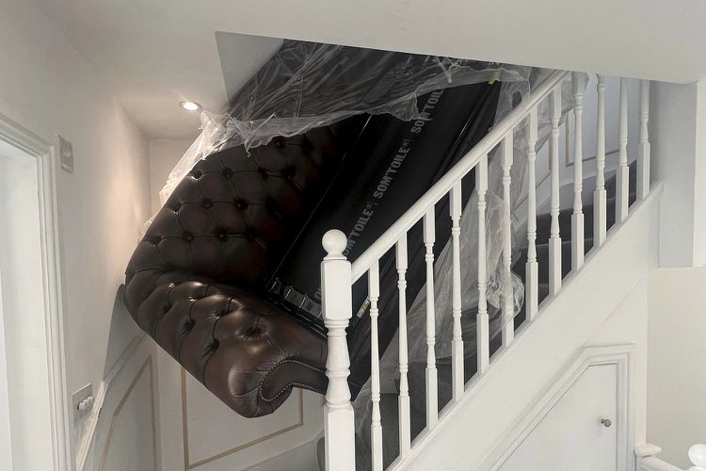
Safety
1. The system shall not destructively alter the environment.
2. The system shall not damage the furniture.
3. The system shall cause less damages than manual moving.

Slide 7

Function
4. The system shall transport furniture repeatedly up and down one floor within a residential building.
5. The system shall be reusable.

Slide 8

Function
6. The system shall accommodate up to a 4-seater sofa.
7. The system shall accommodate up to a 5-shelf bookshelf

Slide 9
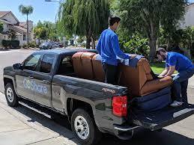
Interfacing
8. The system shall be adaptable to different building layouts.
9. The system shall be transportable in the back of a moving truck.

Slide 10
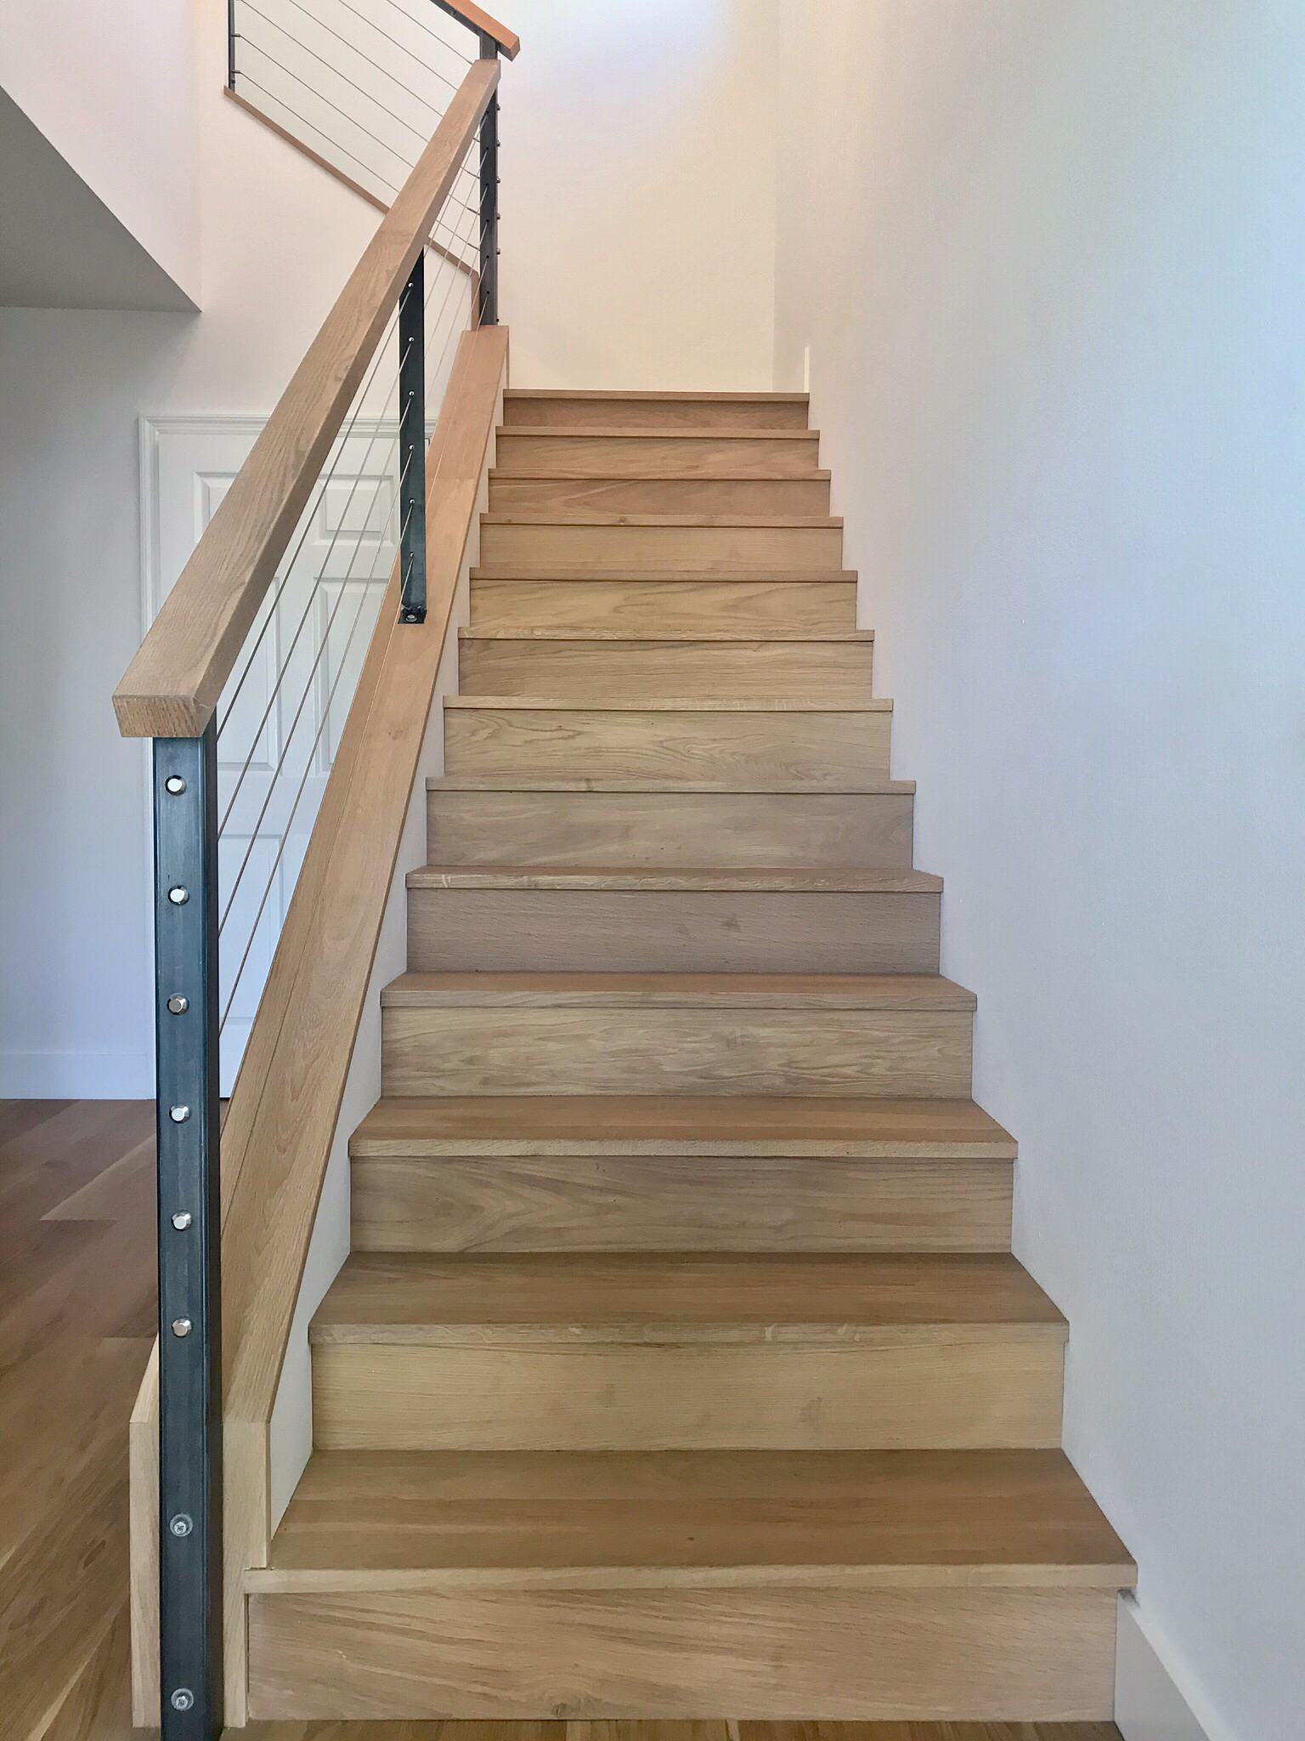
Interfacing
10. The system shall fit within a standard stairway entrance of width 36 in wide according to Section R311.7.1 of the 2021 International Residential Code.
36 in

Slide 11


Questions?

Slide 12
Bibliography
(ICC), I. C. C. (n.d.). 2021 International Residential Code (IRC): ICC Digital Codes. 2021 INTERNATIONAL RESIDENTIAL CODE (IRC) | ICC DIGITAL CODES. https://codes.iccsafe.org/content/IRC2021P2/chapter-3-building-planning#IRC2021P2_Pt03_Ch03_SecR311
broken furniture. (n.d.). clipground. Retrieved September 10, 2023, from https://clipground.com/pics/get.
Clark, E. (2011, May 5). “layering” furniture. Emily A. Clark. https://emilyaclark.com/2011/05/layering-furniture.html
DIY Disaster. (n.d.). Getty Images. Retrieved September 10, 2023, from https://www.gettyimages.co.uk/detail/photo/diy-disaster-royalty-free-image/182062075.
Light Bulb Clip Art - Image #12546. (n.d.). Cliparting. Retrieved September 10, 2023, from https://cliparting.com/free-light-bulb-clip-art-12546/.
Modern staircase ideas. Houzz. (n.d.). https://www.houzz.com/photos/modern-staircase-ideas-phbr1-bp~t_745~s_2105
question mark clipart transparent. (n.d.). Clipartcraft. Retrieved September 10, 2023, from https://clipartcraft.com/download.html.
Savage, S. (2020, January 30). How to move large items in your pickup truck bed. GoShare. https://goshare.co/how-to-move-large-items-in-your-pickup-truck-bed/
Staff, P. (2023, January 26). Pivot! furniture company allegedly abandons sofa wedged in staircase after failed delivery attempt. Peoplemag. https://people.com/home/couch-stuck-in-staircase-photos-delivery-men-abandon-furniture/
To Do List. (n.d.-a). Clipartspub. Retrieved September 10, 2023, from https://clipartspub.com/images/to-do-list-clipart-clipboard-9.jpg.

